Slide 1



Replacing Legacy Bank Account Management System Using Business Rules
Presenters:
Erik Marutian, Project Leader at a CA bank
Jacob Feldman, CTO at OpenRules, Inc.

Slide 2
Problem:
To comply with “Know Your Customer” regulatory requirements, a major California bank needed to urgently extend its legacy on-boarding account management system that supports 6,000+ business users
A new system was supposed to add ~600 dynamically formulated questions using a very complex interaction logic that depends on already answered questions for different customers, accounts, and planned account activities

Slide 3
Challenges:
The old system was not able to support new functional requirements but the old and a new systems should work together (at least for a while)
An immovable delivery deadline as the bank was facing regulatory sanctions
Minimize changes in the user experience as the bank needed to provide training in thousands of branches
Complexity of the interaction logic would make writing the exact specification of new features a very lengthy process

Slide 4

Solution:
The bank understood that only a business rules approach could resolve its problem
After analyzing several off-the-shelf Business Rules products, the bank selected OpenRules. Why?
  Predefined and extendable Excel templates for Pages/Section/Questions implemented in OpenRules Dialog
  An integrated Rule Engine and Rendering Engine

Slide 5
We will share:
How to migrate a complex web application to business rules
How to represent complex interaction logic using decision tables
How to use customize complex interaction and presentation logic using OpenRules Dialog

Slide 6
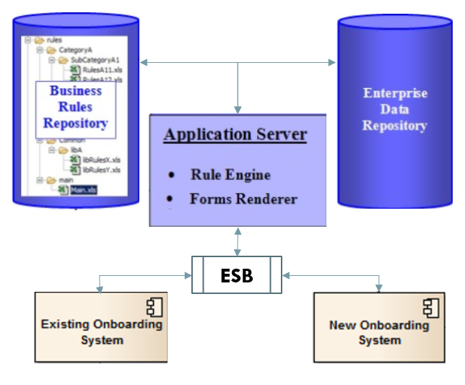
Implementation Architecture
This architecture allowed the existing and new onboarding systems to co-exist and to exchange the customer’s data via Enterprise Data Repository and Enterprise Service Bus (ESB).

Slide 7
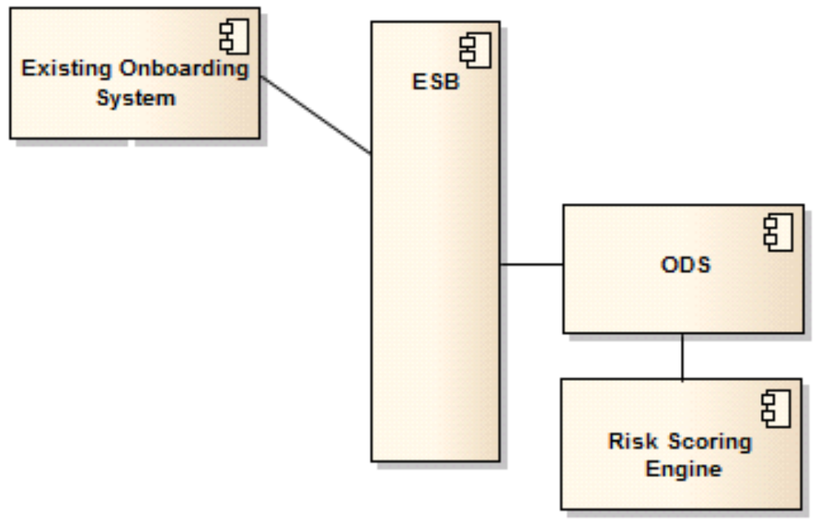
Migrating a complex legacy web application to business rules
  Existing onboarding System
  ESB as communication integration hubs / channels for data flow
  ODS as an enterprise-level data repository
  Risk Scoring Engine as the final destination
The new application is a separate application, but has to look and feel exactly like the existing one
The new application has to integrate with ESB to receive / pass data

Slide 8
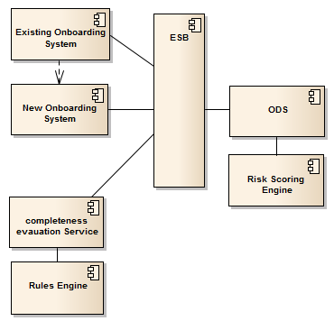
Migrating a complex legacy web application to business rules
A
B
  Existing onboarding System
  ESB as communication integration hubs / channels for data flow
  ODS as an enterprise-level data warehouse
  Risk Scoring Engine as the final destination
  New System extents the onboarding System A by implementing the vast majority of the new Questions / Logic (complexity is over 90%)
  Rules-based Completeness Evaluation Service
E
C
D
F

Slide 9
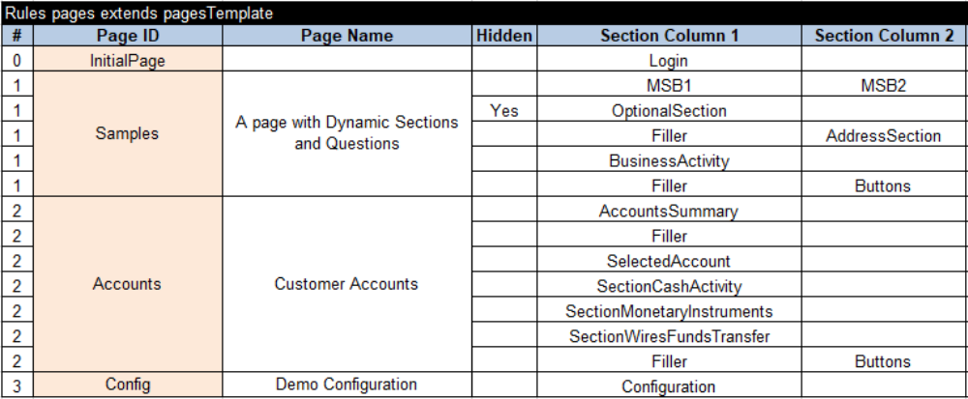
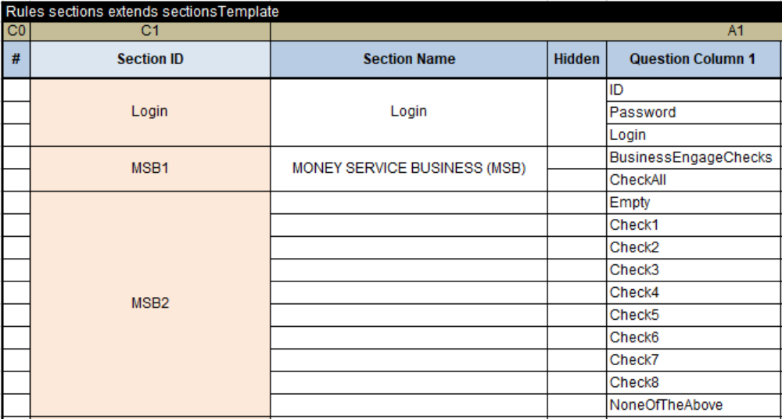
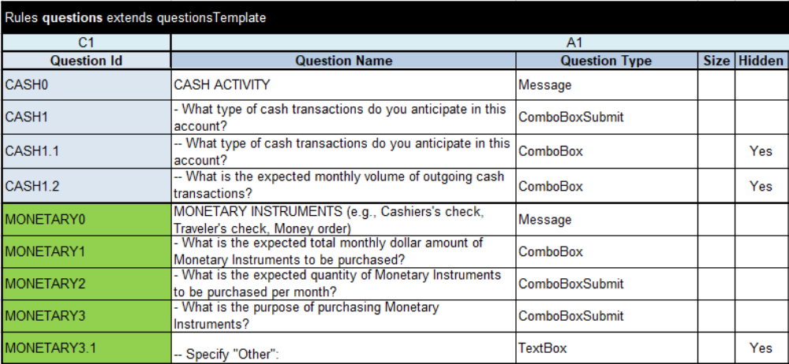
Representing Pages, Sections, Questions in
Excel-based rules tables using predefined templates

Slide 10
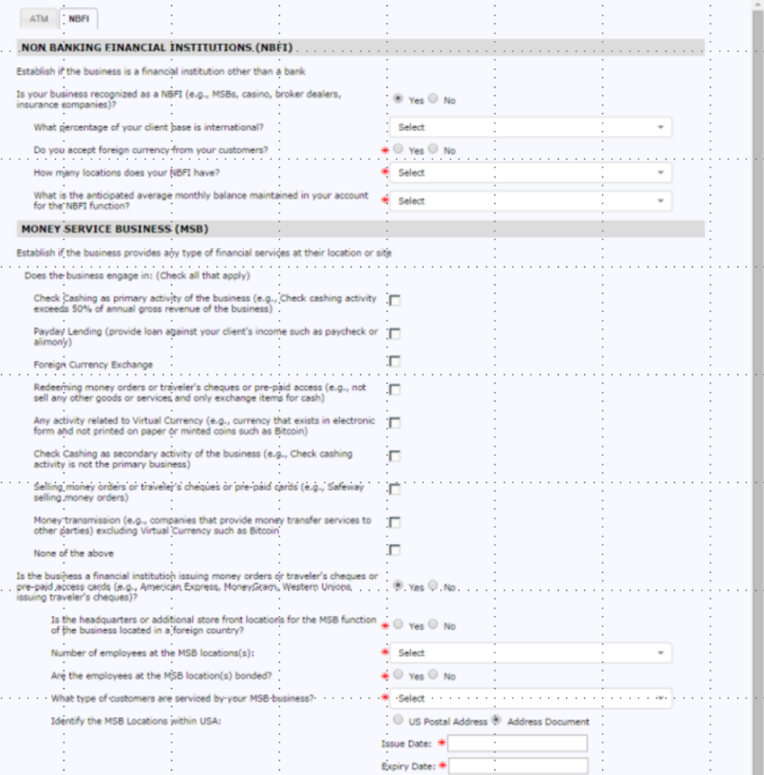
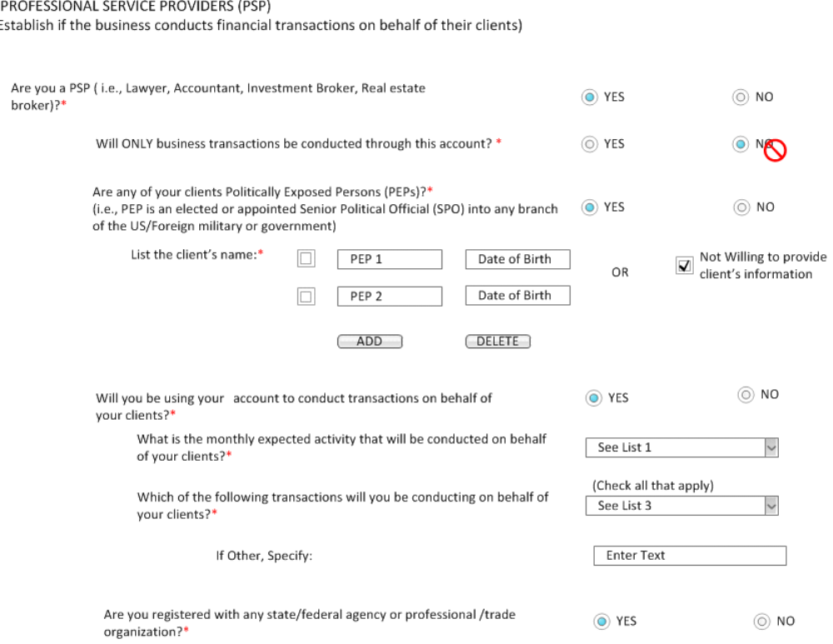
Represent complex interaction logic
  An example of a typical dialog with dynamically modified content
  When a user answers to one question, different questions with different choices should be displayed on the same page

Slide 11
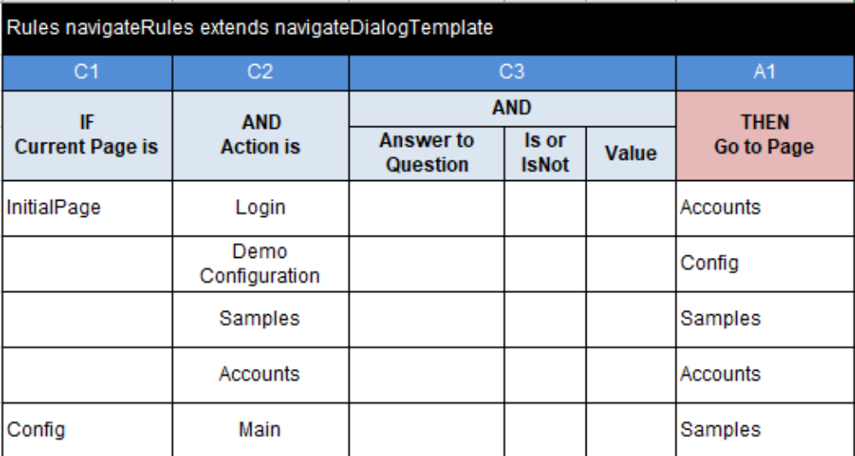
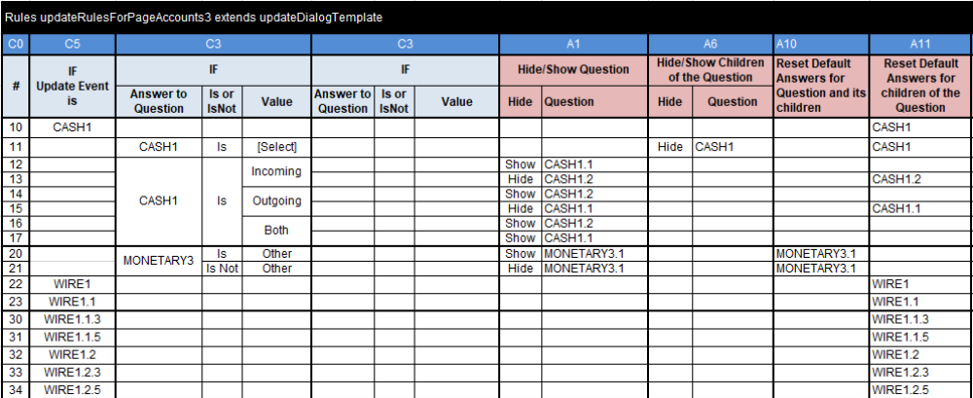
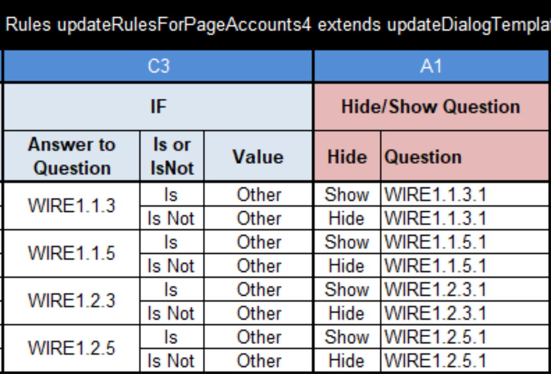
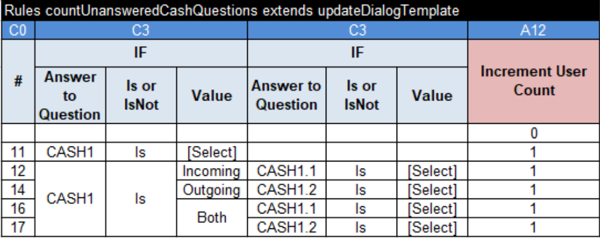
Represent complex interaction logic

Slide 12
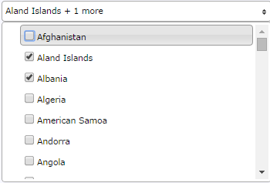
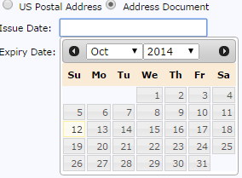
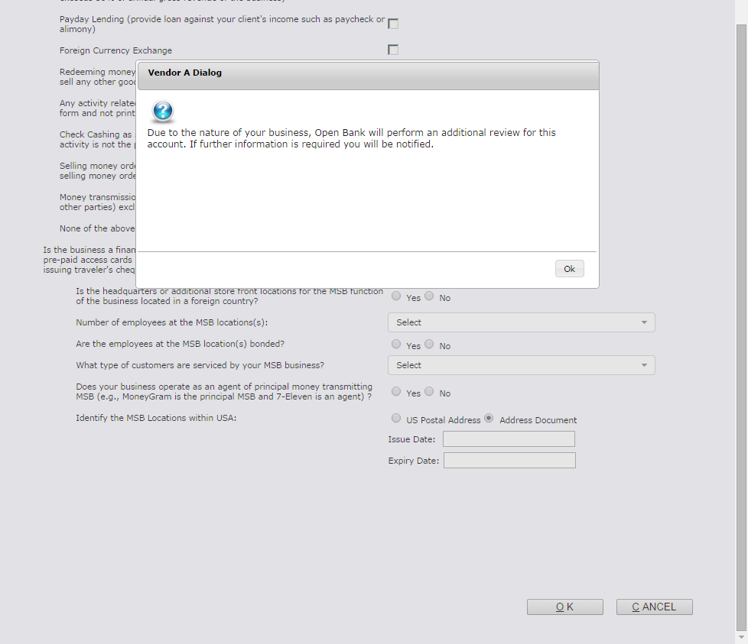
Rich and Flexible GUI Framework
Predefined Forms Renderer with OpenRules Dialog templates
Custom JavaScript, CSS, different type of controls, additional dialog boxes for alerts, confirmations
Flexibility:
  Use ANY js/css frameworks: jquery, tw bootstrap, etc.

Slide 13
Rules-based Approach Advantages
Instead of creating intermediate specifications the team gradually implemented new pages, sections, and questions using rules and layout tables in Excel, which were intuitive enough to be understood by all involved specialists
The important part was the use on the centralized business glossary that provided terminology, uniquely named decision variables and business concepts common for business and technical people
The test cases prepared by business specialists in Excel became an essential part of the rule repository maintained along with the rules to support future modifications

Slide 14
Best Practices, Learning Points and Pitfalls
Best Practices
  Externalized, rules-driven UI logic was easier to document, develop and test
  Minimized documentation while improved communication and collaboration
  Business specialists and developers working in concert
Pitfalls
  Don’t try to develop a rules-based product in house and investigate and compare different off-the-shelf business rules platforms using a clearly defined POC
  General-purpose business rules platforms usually require the development of rules repositories from scratch. Find a platform that already supports domain-specific templates and rules repositories with an ability to be extended and customized

Slide 15
Tangible Improvements
Cost Savings
  The new business rules platform licensing fees are many times less to compare with the existing platform that caused an essential cost saving for the bank
Time Reductions
  The selected approach reduced time-to-market twice by 6 months (twice less) and essentially simplified “specification-implementation-testing” cycle allowing the bank to meet a challenging deadline
Quality Improvements
  The newly developed system not only added a new required functionality but improved the quality of the solution by making it easier to modify, extend, and to learn for new employees
  All of the UI logic was documented in a simple and intuitive, Excel tables

Slide 16
The Technology and Service Provider
OpenRules, Inc.
OpenRules is an open source Business Rules and Decision Management system (http://openrules.com)
Comes with a built-in component, called “OpenRules Dialog” that was specifically designed for building dynamic web-based questionnaires
The predefined and easily customizable templates for interaction rules and for page/section/question layouts played the key role in the success of this development
Minimal learning curve; simple licensing requirements; low cost and a quick development schedule; reliable consulting and training; very responsive technical support

